Slide 1
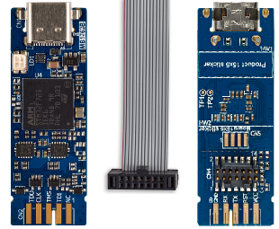
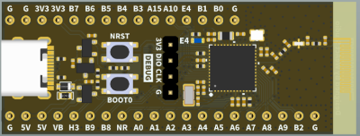
Debugger Connections
Showing both sides of a
STM32 V3MINIE debugger
USART1_RX
USART2_TX

Slide 2
Simple/Easy RaceTemp with only Thermocouple, MAP and NTC
No shielding or decoupling – electric noise can cause problems here, both for the BLE connection and for ADC/sensor accuracy.
Bat Neg = G
Bat Pos = 5V
A0
MAP = A1
NTC = A2
MAP VCC & 1kΩ to NTC = A3
TC NSS = SPI1_NSS = A4
TC SCK = SPI1_SCK = A5
TC SO = SPI1_MISO = A6
SPI1_MOSI = A7
TC VCC = A8
A9
B2
TC GND = G
G
G
3V3
3V3
B7 = USART1_RX
B6 = USART2_TX
B5 = SWO
B4
B3
A15
A10
E4
B1
B0
G = Pres GND

Slide 3
EMI Instructions
Put the battery and the STM32-board inside a shielded box that will be our “chassis” and ground reference. My “shielded box” is a waterproof plastic box with inside lining of aluminium foil tape. Connect Bat. Neg. and STM32 GND to chassis (the aluminium lining). Insulating tape glue? Tape with overlap and it will anyway shield in MHz-range!
Place the BLE antenna next to a window in the aluminium tape. The antenna shall be located/oriented away from wires and electric noise. Do not place the antenna next to the ignition probe.
Add a 100 nF ceramic capacitor to chassis to every wire entering/exiting the shielded box. Those capacitors shall be located as close as possible to the wire exit location in the box and connect to the same piece of tape as the GND (not connected via tape overlap, as the glue might be a DC isolator). See example below for a NTC.
Consider using twisted pair wires and shielded wires!
I designed a PCB with sensor input frontend for:
Thermocouple (Exhaust Temp)
2 pcs NTC (Water or Oil Temp)
RPM (Capacitive HV pickup)
That PCB makes the wiring much easier and more robust with respect to EMI.
GND
NTC
100 nF
10 nF

Slide 4
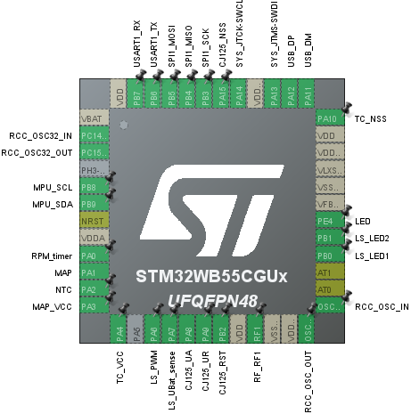
Full Featured RaceTemp with Lambda, EGT, MPU, GPS, RPM, NTC, WaterTemp and more
...but without CAN
Bat Neg = G
Bat Pos = 5V
RPM_timer = A0
MAP = A1
NTC = A2
MAP VCC & 10kΩ to NTC = A3
TC VCC = A4
A5
LS_PWM = A6
LS_UBat_sense = A7
CJ125_UA = A8
CJ125_UR = A9
CJ125_RST = B2
TC GND = G
G = Chassis/box ?
G
3V3
3V3
B7 = USART1_RX
B6 = USART2_TX
B5 = SPI1_MOSI
B4 = SPI1_MISO
B3 = SPI1_SCK
A15 = CJ125_NSS
A10 = TC_NSS
E4 = LED (on board)
B1 = LS_LED2
B0 = LS_LED1
G = Pres GND

